Slide 1
MACHINE LEARNING HOTEL BOOKING
-BY A.ROSHAN

Slide 2
Libraries used in hotel cancellation booking
Numpy
Pandas
Matplotlib
Seaborn
Scikit

Slide 3
Exploring the data and visualization
To predict the hotel cancellation status the data has 32 features.
The features will explain the different dimensions of hotel bookings in various angles.
The features includes arrivals, stays, cancellations, reservations, etc. are included in the dataset.

Slide 4
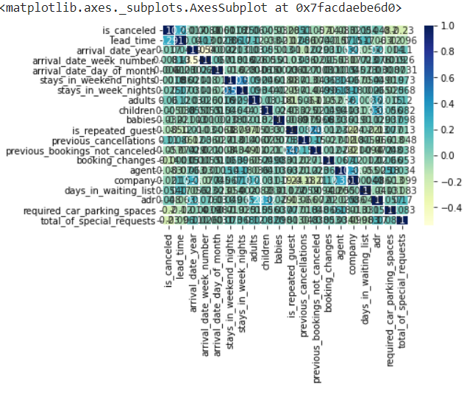
CORRELATION VISUALIZATION
Correlation is one of the most widely used tools in statistics. The correlation coefficient summarizes the association between two variables.

Slide 5
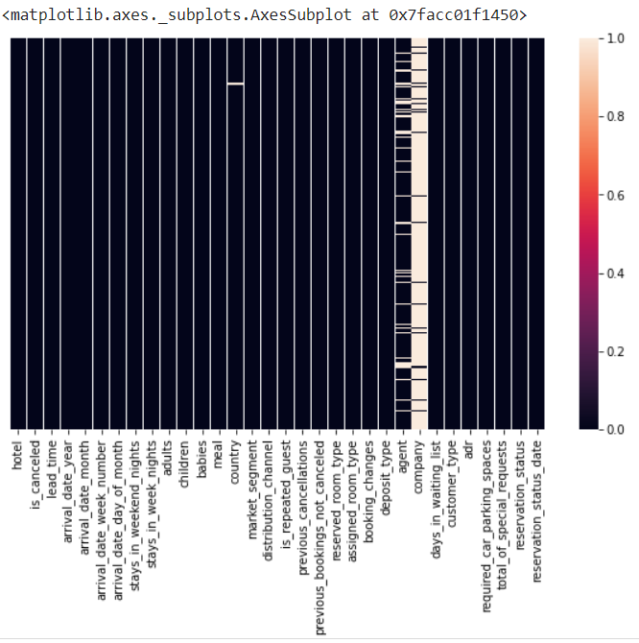
HEAT MAP
A heat map (or heatmap) is a data visualization technique that shows magnitude of a phenomenon as color in two dimensions. The variation in color may be by hue or intensity, giving obvious visual cues to the reader about how the phenomenon is clustered or varies over space

Slide 6
While checking the null values for the features, we have got
FEATURES NULL VALUES Children 4
Country 488
Agent 16340
Company 112593
Remaining Features 0

Slide 7
INFERENCE FOR THE ABOVE DATA
First, correlate the features of the dataset in order to get the relationship between the features.
Then check the null-values of all features and observe the feature named ‘company’ that has high null values. Now, drop that company feature from the dataset.
For the remaining features which consists of null values, they will be replacing with median/mode/mean of that remaining non–null data in that feature.

Slide 8
DATA PREPROCESSING
The data contains different types of datatypes. In order to bring to the single datatype use the label encoder.
Use fit_transform, to get all the features to a same datatype.
Without data preprocessing, it will be difficult to proceed to nextstep,
to apply machine learning algorithms on the dataset.

Slide 9
SPLITTING THE DATA
Use two variables named X and Y
Y with only ‘is canceled’ feature and X with the remaining features
Next step is to split the X into train data and test data with testdata size : 0.4
Similarly, Y is split into train data and test data with testdata size : 0.4

Slide 10
ACCURACY CHECK
To check accuracy use different classifiers which can be imported from scikit libraries.
For logistic regression the test accuracy score and train accuracy score will be around 0.989.
Go through several classifiers in order to improve the accuracy score than the logistic regression.
The accuracy score for the decision tree is 100%.

Slide 11
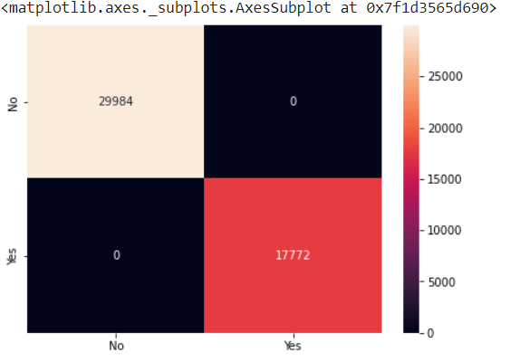
Confusion matrix for decision tree

Slide 12
conclusion
Break down the dataset into smaller and smaller subsets while at the same time incrementally develop the associated decision tree.
The criterion for ‘gini’ and max depth 3.
Thus, by accuracy score and confusion matrix it can be concluded that decision tree classifier is the best.

